Slide 1
SQL Server Fundamentals

Slide 2
Session Agenda

Slide 3
Why is RDBMS?
In traditional approach, information is stored in flat files.
Application programs go through the file system to access these flat files.
Drawbacks of Traditional Approach:
Unable to achieve Data Safety
Concurrent Access
Fault Tolerance
Data Integrity
Reporting

Slide 4
What is RDBMS?
A Relational Database management System is a database management system
First published by E.F. Codes in 1970.
RDBMS is used to manage Relational database.
It is a collection of organized set of tables from which data can be accessed easily.
In RDBMS, each table has its own primary key.
Today almost all RDBMS (MSSQL, MySql, Oracle, Infomix, Sybase, MS Access) uses SQL.
SQL is a query language used for storing and managing data in RDBMS.
SQL is used to perform all type of data operations in RDBMS.

Slide 5
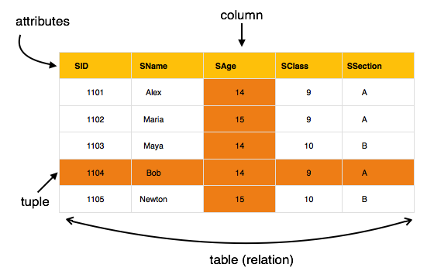
Example: Student Table

Slide 6
RDBMS Language
DDL – Data Definition Language
DML – Data Manipulation Language
DCL – Data Control Language
TCL – Transactional Control Language

Slide 7
Data Definition Language
DDL is abbreviation of Data Definition Language.
It is used to create and modify the structure of database objects in database.
CREATE – Creates objects in the database
ALTER – Alters objects of the database
DROP – Deletes objects of the database
TRUNCATE – Deletes all records and resets table to initial stage.

Slide 8
Data Manipulation Language
DML is abbreviation of Data Manipulation Language.
It is used to retrieve, store, modify, delete, insert and update data in database.
SELECT – Retrieves data from a table
INSERT – Inserts data into a table
UPDATE – Updates existing data into a table
DELETE – Deletes all records from a table

Slide 9
Data Control Language
DCL is abbreviation of Data Control Language.
It is used to create roles, permissions, and referential integrity
It is also used to control access to database by securing it.
GRANT – Gives user’s access privileges to database.
REVOKE – Withdraws user’s access privileges.

Slide 10
Data Transactional Language
TCL is abbreviation of Transactional Control Language.
It is used to manage different transactions occurring within a database..
COMMIT – Saves work done in transactions.
ROLLBACK – Restores database to original state since the last COMMIT command.
SAVE TRANSACTION – Sets a SAVEPOINT within a transaction.

Slide 11
Data Types in SQL Server
String
Char(n) – Fixed Non-Unicode
Varchar(n) – Variable Non-Unicode
nChar(n) – Fixed Unicode
nVarchar(n) – Variable Unicode
Number
Int, biginit, smallint and tinyint
Decimal and numeric
Float and real
Money and smallmoney

Slide 12
Data Types in SQL Server
DateTime
Date
Time
DateTime
DateTime2
SmallDateTime
Unique Identifier

Slide 13
SQL Server Group Functions

Slide 14
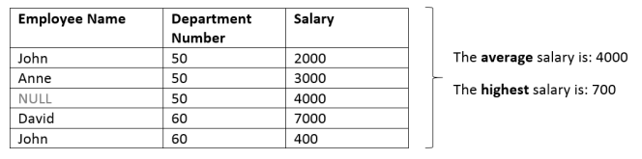
SQL Server Group Functions
SQL Server Group Functions operate on sets of rows to give one result per group.
For Example,

Slide 15
SQL Server Common Group Functions
Function | Description
SUM | Returns the total sum
MIN | Returns the lowest value
MAX | Returns the highest value
AVG | Returns the average value
COUNT(*) | Returns the number of records in a table
COUNT(Column) | Returns the number of values (NULL values will not be counted) of the specified column
COUNT(DISTINCT Column) | Returns the number of distinct values

Slide 16
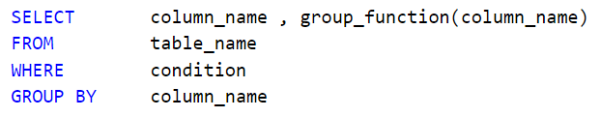
The GROUP BY Clause
Group by clause is used to group a selected set of rows into a set of summary
It is always used in conjunction with one or more aggregate functions.

Slide 17
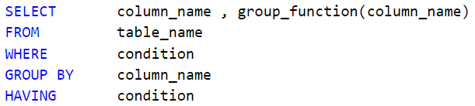
The HAVING Clause
The HAVING clause allows filtering of aggregated results produced by GROUP BY clause.
I.e. we use the SQL Server HAVING clause to restrict groups.

Slide 18
Difference between WHERE and HAVING clause:
WHERE clause can be used with - Select, Insert, and Update statements, where as HAVING clause can only be used with the Select statement.
WHERE filters rows before aggregation (GROUPING), where as, HAVING filters groups, after the aggregations are performed.
Aggregate functions cannot be used in the WHERE clause, unless it is in a sub query contained in a HAVING clause, whereas, aggregate functions can be used in Having clause.

Slide 19
Points to Be Noted:
Sequence of Executing Query (FWGHO):
The FROM clause assembles the data from the data sources.
The WHERE clause restricts the rows based on the conditions.
The GROUP BY clause assembles subsets of data.
Aggregate functions are calculated.
The HAVING clause filters the subsets of data.
Any remaining expressions are calculated.
The ORDER BY sorts the results.

Slide 20
Points to be Noted:
All Group functions ignore NULL values.
You can use the ISNULL function to force group functions to include NULL values.
All columns in SELECT clause that are not grouped must be in the GROUP BY clause.
Using the WHERE clause, you can exclude rows before dividing them into groups.
You cannot use the SQL Server WHERE clause to restrict groups.

Slide 21
SQL Server Joins

Slide 22
SQL Server Joins
Join: used to extract data from multiple tables.
Joins are further divided in various types:
Inner Join
Outer Join
Left Outer Join
Right Outer Join
Full Outer Join
Self Join
Cross Join

Slide 23
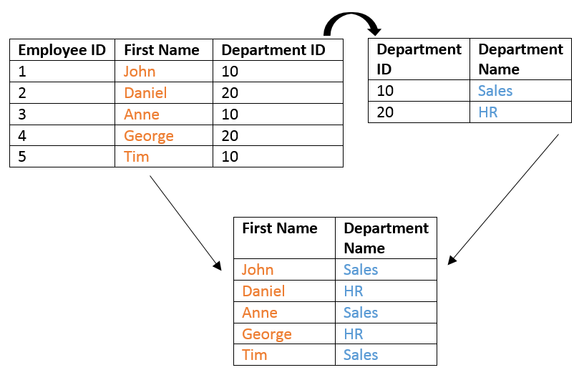
SQL Server – Inner Join
Retrieves only matched rows from Left and Right Table.
Inner joins are also called Simple Joins or Equi Joins.

Slide 24
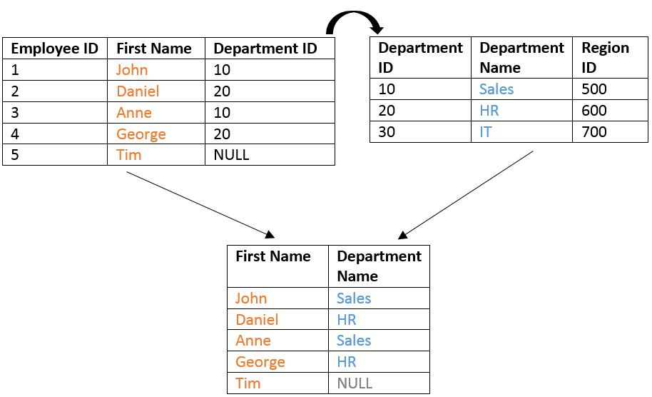
SQL Server – Left Outer Join
Retrieves all the rows from Left table and matched from Right Table.

Slide 25
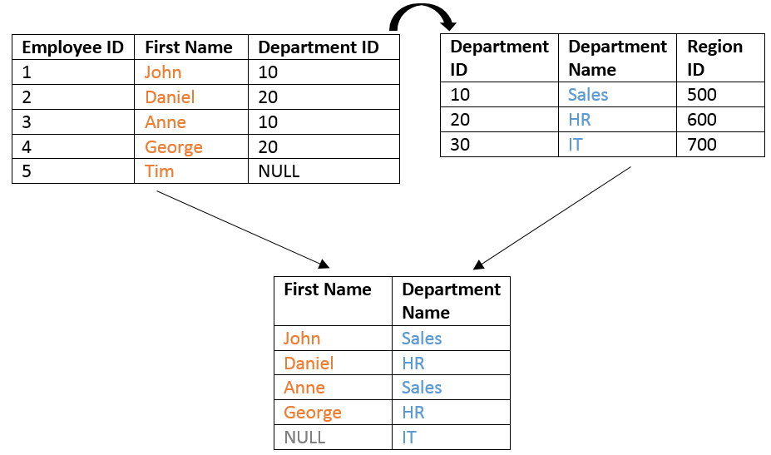
SQL Server – Right Outer Join
Retrieves all the rows from Right table and matched from Left Table.

Slide 26
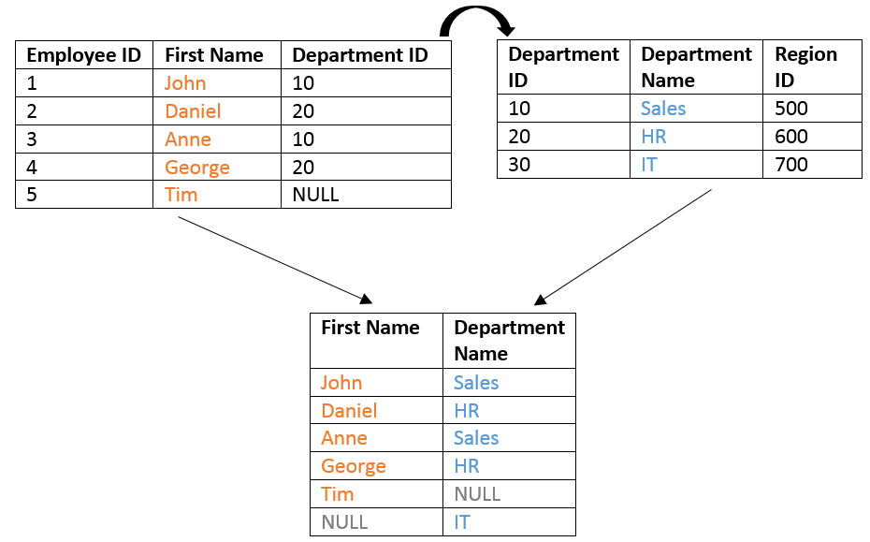
SQL Server – Full Outer Join
Retrieves all the rows from Left and Right Table.

Slide 27
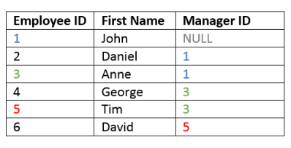
SQL Server – Self Join
The SQL Server Self Join allows joining a table to itself.
Such as an Employee table consists the information of employees and their managers.

Slide 28
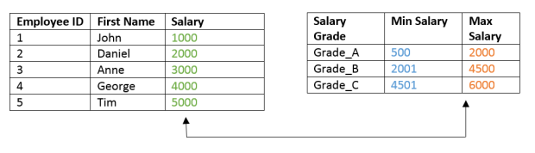
SQL Server – Non-Equi Join
A Non-Equi Join is a join condition containing something other than equality operator.
E.g. sometimes you would like to join two tables that do not have a shared column, and seemingly have no join condition:

Slide 29
SQL Server – Cross Join
A cross join is used when you wish to create combination of every row from two tables.
This kind of result is called as Cartesian Product.
This join is applied implicitly applied in two conditions:
If the join condition is omitted.
If the join condition is invalid.

Slide 30
SQL Server Sub-Queries

Slide 31
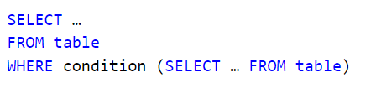
Sub-Queries
Subquery or Inner query or Nested query is a query inside a query.
Outer query is executed based upon the results of inner query.
Basic SQL Server Subquery Syntax:
The subquery must be enclosed by round brackets.
Place subqueries on the right side of the comparison condition.
A subquery cannot be placed in the SQL Server GROUP BY Clause.

Slide 32
Types of Sub-Queries
Sub-queries can be divided into two main categories :
Single Row Subqueries:
subqueries that return zero or one row to the outer SQL statement.
We may use the <, >, <=, >=, = and <> operators (Single Row Operators)
Multiple Row Subqueries:
subqueries that return more than one row to the outer SQL statement.
You may use the IN, ANY, or ALL operators (multiple row operators)

Slide 33
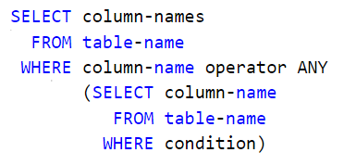
SQL WHERE ANY, ALL Clause
ANY and ALL keywords are used with a WHERE or HAVING clause.
ANY and ALL operate on subqueries that return multiple values.
ANY returns true if any of the subquery values meet the condition.
ALL returns true if all of the subquery values meet the condition.

Slide 34
SQL Server Views

Slide 35

SQL Server Views
A logical or virtual table based on a table or another view is called View.
It contains no data of its own.
It is like a window through which data from tables can be viewed.
The tables on which a view is based are called base tables.
The view is stored as a SELECT statement in the dictionary.
There are two types of views:
System Defined Views and User Defined Views

Slide 36
Advantages of Views
To restrict data access
To make complex queries easy
To provide data independence
To present different views of the same data

Slide 37
System Defined Views
The system defined views are predefined views.
They already exist in the Master database of SQL Server.
These system views are automatically attached to any user defined DB.
System Defined View
Information Schema View
Catalog View
Dynamic Management View

Slide 38
Information Schema View
In SQL Server we have twenty different schema views.
These are used to display information of DB, like as tables and columns.
This type of view starts with INFORMATION_SCHEMA.
These are of two types:
Server-scoped Dynamic Management View: Stored in Master Database
Database-scoped Dynamic Management View: Stored in Each Database
Example,
Select * from information_schema.Columns

Slide 39
Catalog View
These are used to show database self describing information.
Example,
Select * from sys.Tables

Slide 40
Dynamic Management View
These Views give the administrator information of the database about the current state of the SQL Server machine.
These values help the administrator to analyze problems and tune the server for optimal performance.
Example,
SELECT Connection_id, session_id, client_net_address
FROM SYS.DM_EXEC_CONNECTIONS

Slide 41
User Defined Views
Features | Simple View | Complex View
Number of Tables | One | One or More
Contain Functions | No | Yes
Contain groups of Data | No | Yes
DML Operations through a View | Yes | Not Always
We can only update data in complex view. We can't insert data in complex view.

Slide 42
Points to be Noted:
We make views for security purpose.
It restricts the user to view all data.
The end user is not aware of all the data present in database table.
In Information Schema View, we fetch the information about DB.
In Catalog View, we fetch the self describing information about DB.
In DM View, we fetch the information about the current state of the DB.
In Simple View, we create a view on a single table.
In Complex View, we create a view on more than one table.

Slide 43
SQL Server Indexes

Slide 44

What are Indexes?
Indexes are used by queries to find data from tables quickly.
Indexes are created on tables and views.
If there is no index, then the query engine checks every row in the table
This is called Table Scan. Table scan is bad for performance.
An index on a column can be created as follows:

Slide 45

Index Example:
An index stores Order Amount of each order in the ascending order as below:
ID | Order Number | Order Amount
1 | 542378 | 2500
2 | 542379 | 6500
3 | 542380 | 4500
4 | 542381 | 5500
5 | 542382 | 3100
Order Amount | Row Address
2500 | Row Address
3100 | Row Address
4500 | Row Address
5500 | Row Address
6500 | Row Address
Map To

Slide 46

Index Example:
Now, the SQL Server has to execute the query where it has the index on the OrderAmount column and fetch OrderAmount between 5000 and 7000 such as
Thus, SQL Server picks up the row address from the index and directly fetch the records from the table, rather than scanning each row in the table. This is called Index Seek.

Slide 47
Types of Indexes
Clustered
Non-Clustered
Unique
Filtered
XML
Full-Text
Spatial
ColumnStore
Index with Included Columns
Index on Computed Columns

Slide 48
Clustered Index
A clustered index determines the physical order of data in a table.
Primary key constraint creates clustered index.
A table can have only one Clustered Index.
A clustered index that contains multiple columns is called Composite Index.
For Example, A telephone directory is organized by last name and first name. (Composite Index)

Slide 49

Non-Clustered Index
A non-clustered index is similar to an index in the textbook.
The data is stored in one place, and the index in other place.
This index will have pointers to the storage location of the data.
A table can have more than one non-clustered indexes.
The data is stored in ascending and descending order of the index key.

Slide 50
Clustered and Non-Clustered Index
Only one clustered index per table whereas we can have more than one non-clustered index in a table.
Clustered Index is faster than Non-Clustered Index.
Clustered Index determines the physical storage order of rows in the table in the table only whereas Non-Clustered index stored separately from the table, additional storage space is required.

Slide 51

Unique Index
Unique index is used to enforce uniqueness of key values in the index.
Uniqueness is a property of index.
Both Clustered and Non-Clustered indexes can be unique.
By default, Primary Key constraint creates a unique clustered index.
Unique Non-Clustered index can be created as follows:

Slide 52
SQL SERVER FUNCTIONS

Slide 53
SQL SERVER STORED PROCEDURES

Slide 54
Stored Procedures
Stored procedure is a named group of SQL statements.
They are created and stored in the server database.
They reduce network traffic and improve performance.
They can be used to help ensure the integrity of the database.
They contain a collection of pre-complied T-SQL statements .
They are processed as a single unit.

Slide 55
Types of Stored Procedures
Types of Stored Procedures
System-defined Stored Procedures
Extended Stored Procedures
User-defined Stored Procedures

Slide 56
Types of Stored Procedures
System Stored Procedures:
Supplied by SQL Server and are precompiled version of T-SQL statements.
Used to report and manage information in the system. They begin with ‘sp_’
User-defined Stored Procedures:
We can create our own Stored Procedures, compile them execute them.
They can begin with usp.
Extended Stored Procedures:
These SPs work outside SQL Server and are stored as DLLs and are executed dynamically. They begin with ‘xp_’

Slide 57
Stored Procedure Advantages
Modularity
Encapsulation
Performance
Reusability
Precompiled Execution
Cache Plan
Enhances Security control
Reduce Network traffic

Slide 58
Variables in Stored Procedures
Variables are defined memory locations.
They are defined with a specific name and contain some value.
Variables are mainly used for calculations or to store some value.
The name of the local variable must be prefixed with ‘@’ sign.
‘DECLARE’ keyword is used to declare a variable.
‘SET’ keyword is used to assign a vale to a variable.

Slide 59
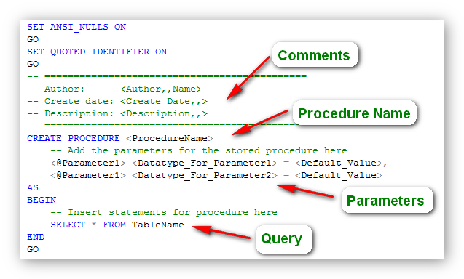
Creating a Procedure

Slide 60
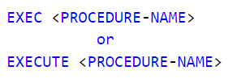
Executing a Procedure
We can execute a complied stored procedure with the use of ‘EXEC’ or ‘EXECUTE’ command:

Slide 61
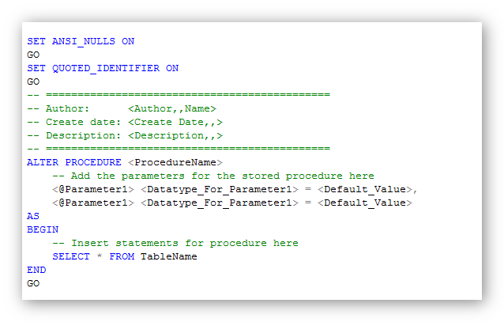
Altering a Procedure

Slide 62

Dropping Stored Procedure
Stored Procedures can be dropped using DROP statement similar to other DB Objects.

Slide 63
System Defined Stored Procedure
These stored procedure are already defined in SQL Server.
These are physically stored in hidden SQL Server Resource Database.
These procedure starts with the sp_ prefix.
Hence we don't use this prefix when naming user-defined procedures.

Slide 64
System Defined Stored Procedure
System Procedure | Description
sp_rename | It is used to rename an database object.
sp_changeowner | It is used to change the owner of an database object.
sp_help | It provides details on any database object.
sp_helpdb | It provide the details of the databases.
sp_helptext | It provides the text of a stored procedure reside in SQL
sp_depends | It provide the details of all dependent database objects

Slide 65
SQL SERVER STORED PROCEDURES

Slide 66
Triggers
A trigger is an action that is performed behind-the-scenes when an insert, update
or delete operation has been performed on a table.
The trigger must be created in connection to a table of a non-system database
Triggers are of 2 types in SQL Server:
DML Triggers
AFTER Triggers
INSTEAD OF Triggers
DDL Triggers

